Slide 1
Internet & Web
Lab 12: Web Development.

Slide 2
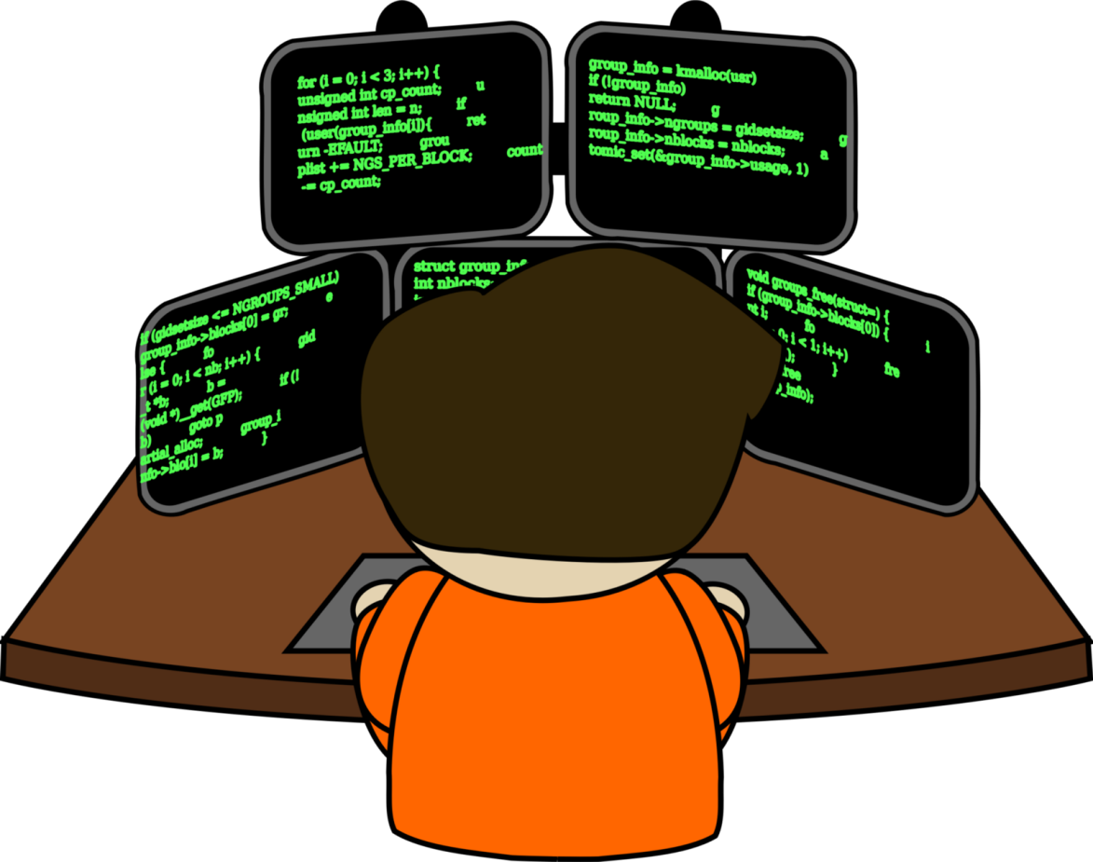

Welcome to Internet & Web Class

Slide 3

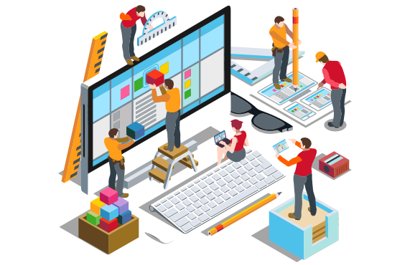
What is Web Development?
Web development process includes web design, web content development, client-side/server-side scripting

Slide 4

HTML
HTML was developed by W3C & WHATWG and first introduced in 1993.
Hypertext Markup Language (HTML) is the standard markup language for creating web pages and web applications with Cascading Style Sheets (CSS) and JavaScript, it forms a triad of cornerstone technologies for the World Wide Web.

Slide 5
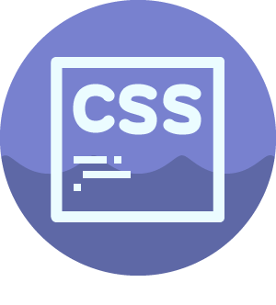
CSS
Cascading Style Sheets (CSS) is a style sheet language used for describing the presentation of a document written in a markup language like HTML.
CSS is a cornerstone technology of the World Wide Web, alongside HTML and JavaScript.
CSS is designed to enable the separation of presentation and content, including layout, colors, and fonts.

Slide 6

JavaScript
JavaScript is the programming language of HTML and the Web.
JavaScript is easy to learn.
Alongside HTML and CSS, JavaScript is one of the three core technologies of the World Wide Web. JavaScript enables interactive web pages and thus is an essential part of web applications.

Slide 7

php
It was originally created by Rasmus Lerdorf in 1994 .
PHP is a powerful tool for making dynamic and interactive Web pages.
PHP code may be embedded into HTML code, or it can be used in combination with various web template systems, web content management systems, and web frameworks.

Slide 8

ASP .Net
ASP.NET is an open-source server-side web application framework designed for web development
Easy to learn, understand, and use
Uses an SPA application model (Single Page Application)
Similar to PHP and Classic ASP
VB (Visual Basic) or C# (C sharp) scripting languages

Slide 9
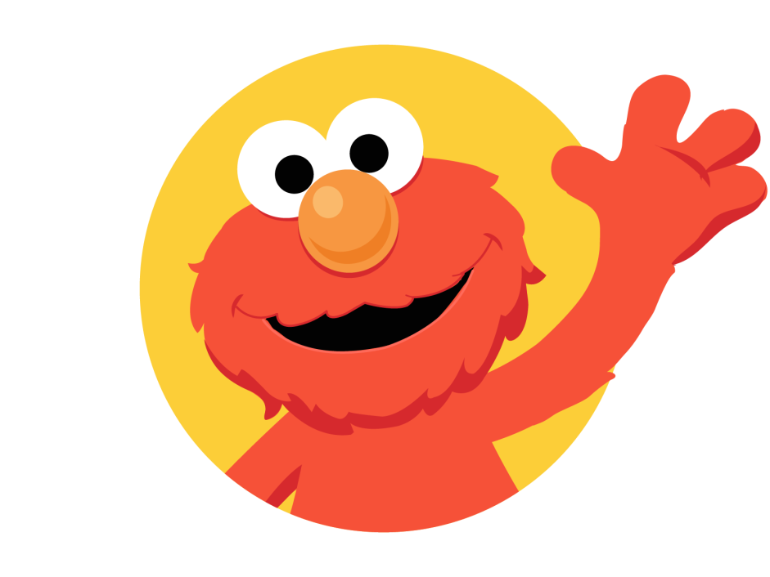
Today’s learning:
HTML
CSS
JavaScript
php
ASP .Net
Thank You!

